Slide 1
Alteryx AI FACT SHEETS
October 2024

Slide 2

Alteryx: Who We Are
Background
Operating in the Middle of the AI Value Chain
Foundation Model Developers
AI System Integration and Application Development
AI System Deployers
+
Customers

Slide 3
Four Levels of Detail
Alteryx’s Approach to Transparency Documentation
Tailored to convey key information for different audiences and uses
AI
Fact Sheet
Product FAQs
Terms of Use
Product Documentation
Easily accessible answers to common questions
Additional detail on common questions
Full documentation of legal and contractual considerations
Full technical
documentation

Slide 4
Transparency Goals
Alteryx’s Approach to Transparency Documentation
Customer Questions
Regulator/ External Stakeholder Interest
Commitment to AI Responsibility
Focus of AI Fact Sheets

Slide 5
Developing Fact Sheet Content
Creating the AI Fact SHeet
A Lifecycle Approach
ALTERYX AI FACT SHEET
Data Protection
Risk Assmt
AI Risk Assmt
Product FAQs
Project Conception
AI System Integration
Product Launch
Product Updates

Slide 6
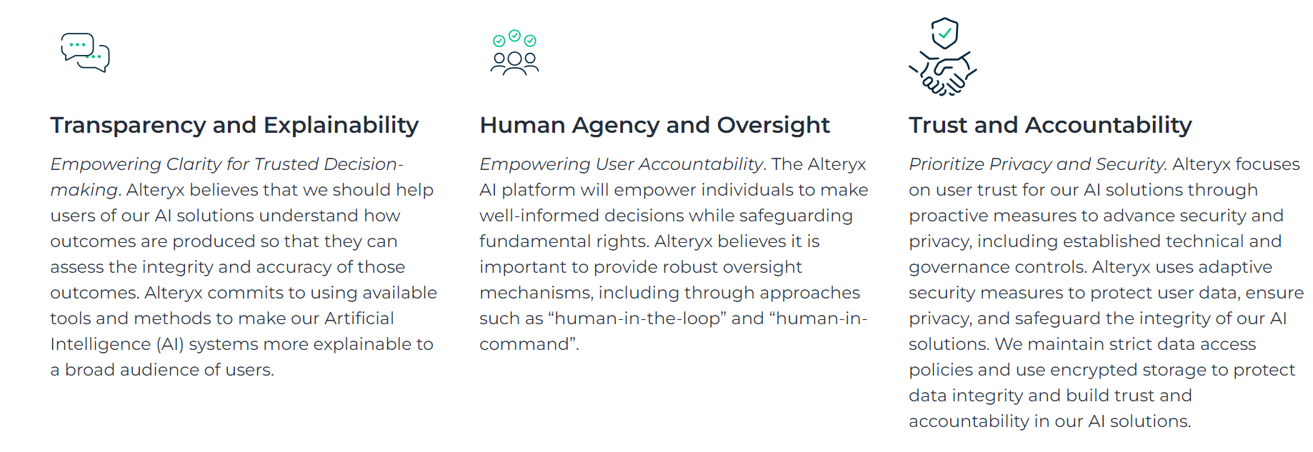
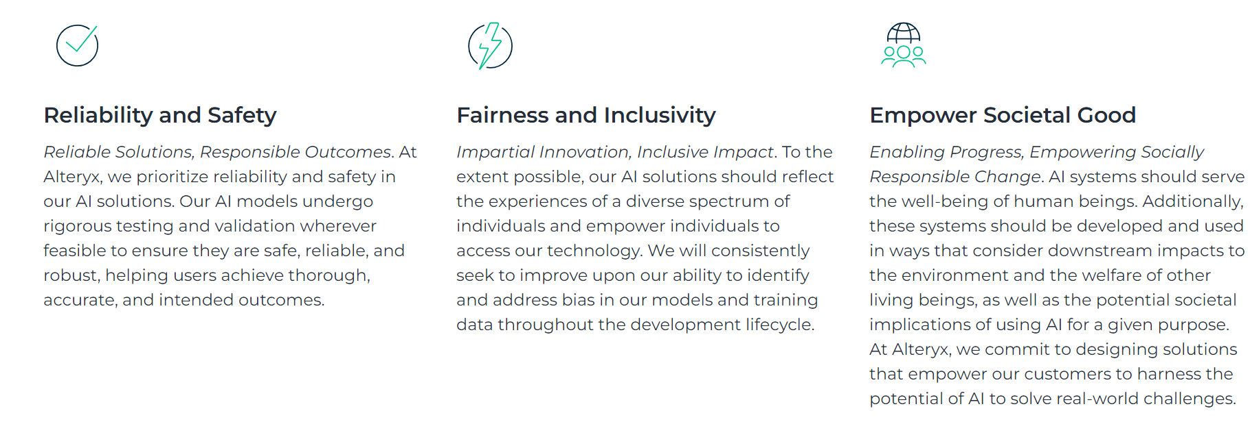
Alteryx’s Responsible AI Principles
The Foundation for Alteryx AI Fact Sheets

Slide 7
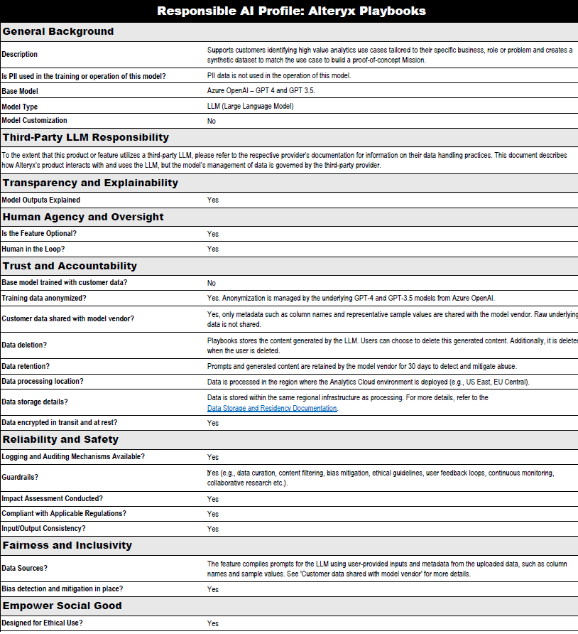
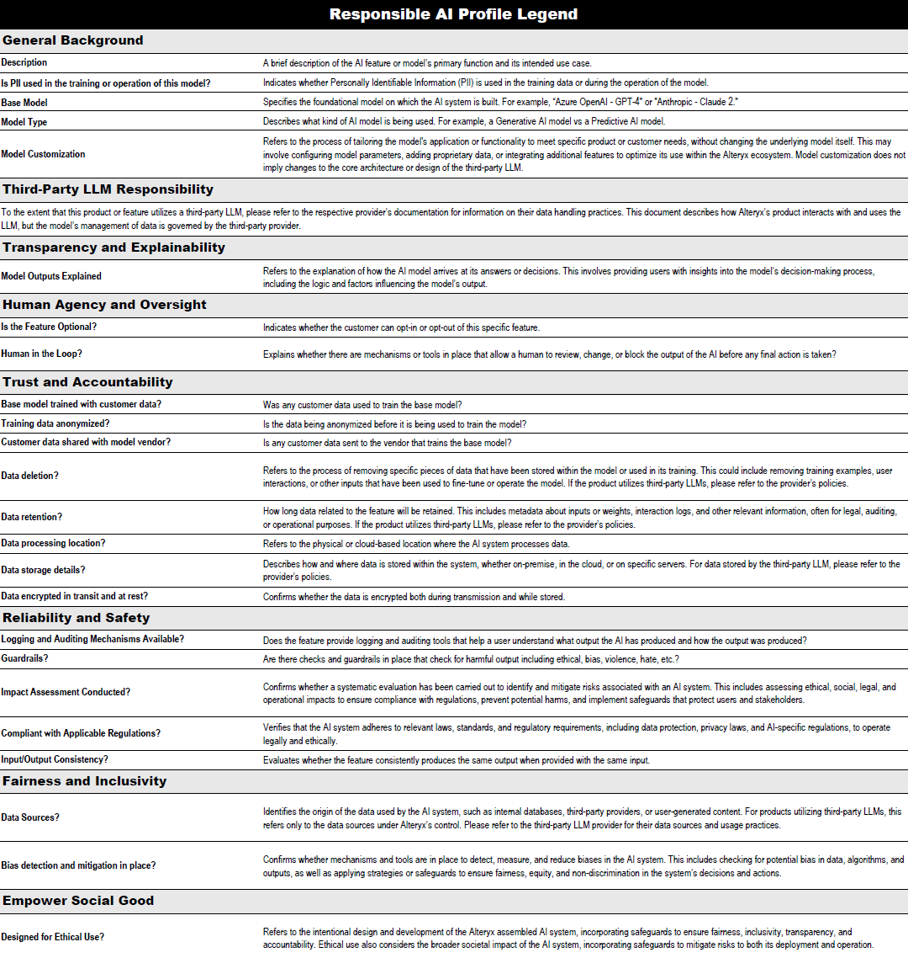
Alteryx AI Fact Sheet Playbooks
Legend

Slide 8
Alteryx AI Fact Sheet Legend
Playbooks

Slide 9
Mapping AI Facts Sheet to the GenAI RMF Profile
Alteryx AI Fact Sheet | NIST AI RMF GenAI Profile
General Background
Description |  | MS-2.9
Is PII used in the training of this model? |  | GV-6.1; MS-2.9
Base model |  | MS-2.9
Model type |  | MS-2.9
Model customization |  | MS-2.5; MS-2.9
Third-Party LLM Responsibility
 |  | MG-3.1
Transparency and Explainability
Model outputs explained |  | MS-4.2
Human Agency and Oversight
Is the feature optional? |  | MS-2.2
Human-in-the-loop? |  | MS-4.2
Trust and Accountability
Base model trained with customer data? |  | GV-1.2; MS-2.2; MG-3.2
Training data anonymized? |  | MP-4.1; MS-2.2
Customer data shared with model vendor? |  | MP-4.1
Data deletion?
Data retention? |  | MP-4.1
Data processing location?
Data storage details? |  | MP-4.1
Data encrypted in transit and at rest?
Alteryx AI Fact Sheet | NIST AI RMF GenAI Profile
Reliability and Safety
Logging and auditing mechanisms available? |  | MG-4.3
Guardrails? |  | MS-2.5; MS-2.6; MS-2.7
Impact assessment conducted? |  | GV-1.3; MP-4.1; MS-1.3, MS-3.3
Compliant with applicable regulations? |  | GV-1.1; MS-2.9; MG-4.3
Input/Output consistency? |  | MS-2.6
Fairness and Inclusivity
Data sources? |  | GV-1.2; MS-2.9; MG-3.2
Bias detection and mitigation in place? |  | MS-2.6; MS-2.11; MG-2.2
Empower Social Good
Designed for ethical use? |  | GV-1.3; MP-1.1; MS-2.9

Slide 10
A few initial lessons
Alteryx’s Experience
AI Fact Sheets and the GenAI RMF Profile
A single transparency product or document is unlikely to meet all organizational needs.
May be worth considering various VRT options: VRT “light,” “medium,” and “detailed” views, for instance.
There is a huge demand on AI integrators for transparency documentation, but much of the GenAI RMF profile is not necessarily relevant.
Need to ensure that a VRT establishes appropriate expectations based on roles within the AI ecosystem.
Doing so requires definitional clarity on different AI ecosystem roles.
There may be some mismatches between the GenAI RMF and most pressing customer transparency interests.
Many good practices included to address training data, but less attention to how user/customer data is collected, used, stored, protected, and deleted.

